Slide 1
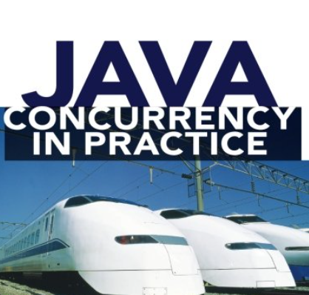

Slide 2
Agenda
Not about multi threading concepts
Writing a good concurrency code: A challenging task
About best practices – Basics to advanced

Slide 3
Scalable Cache in Concurrent Environment
How to create a scalable cache in a concurrent environment
Attempt 1:
public class Attempt1 {
private final ConcurrentHashMap<String, String> cache = new ConcurrentHashMap<String, String>();
public String getValue(String key){
if(cache.get(key)!=null){
return cache.get(key);
}else{
return compute(key);
}
}
public String compute(String key){
//Perform long computation....
String value = new String();
cache.put(key, value);
return value;
}
}

Slide 4
Scalable Cache in Concurrent Environment
Concurrent Hash Map will give good performance along with synchronization
Still, you might end up evaluating value two times for the same key.
Is there any way where when same key is encountered then instead re-evaluating the value we can somewhat get value from previous run
Yes, there is, Use Future
Solution Approach

Slide 5
Scalable Cache in Concurrent Environment
public class Attempt2 {
private final ConcurrentHashMap<String, Future<String>> cache = new ConcurrentHashMap<String, Future<String>>();
public String getValue(String key){
String value = null;
if(cache.get(key)!=null){
Future<String> valueFuture = cache.get(key);
try {
value = valueFuture.get();
} catch (InterruptedException e) {
// TODO Auto-generated catch block
e.printStackTrace();
} catch (ExecutionException e) {
// TODO Auto-generated catch block
e.printStackTrace();
}
}else{
value = compute(key);
}
return value;
}
public String compute(String key){
String value = null;
FutureTask<String> valueFuture = new FutureTask<String>(new Callable<String>() {
@Override
public String call() throws Exception {
//Perform long computation....
String value = new String();
return value;
}
});
//Put value in cache before actual computation
cache.put(key, valueFuture);
valueFuture.run();
try {
value = valueFuture.get();
} catch (InterruptedException e) {
// TODO Auto-generated catch block
e.printStackTrace();
} catch (ExecutionException e) {
// TODO Auto-generated catch block
e.printStackTrace();
}
return value;
}
}

Slide 6
Submitting Multiple Result Bearing Tasks
If you have multiple tasks which evaluates some value then, you will be using Callable instead of Runnable
Attempt 1:
public class FutureWithoutCompletionService {
public void execute() throws InterruptedException, ExecutionException{
ExecutorService executor = Executors.newFixedThreadPool(5);
for(int i=0; i<1000;i++){
Future<Integer> taskFuture = executor.submit(new ResultBearingTask());
int j = taskFuture.get();
}
}
private static class ResultBearingTask implements Callable<Integer> {
@Override
public Integer call() throws Exception {
return new Integer(1);
}
}
}

Slide 7
Submitting Multiple Result Bearing Tasks
public class FutureWithCompletionService {
public void execute() throws InterruptedException, ExecutionException{
ExecutorService executor = Executors.newFixedThreadPool(5);
CompletionService<Integer> completionService = new ExecutorCompletionService<Integer>(executor);
//So lets process 1000 records concurrently with 5 Threads using result bearing Callable Task
for(int i=0; i<1000;i++){
completionService.submit(new ResultBearingTask());
}
for(int i=0; i<1000;i++){
Future<Integer> future = completionService.take();
try {
//Please note that this timeout will be calculated from the moment when we called get..
//not from the moment when task was submitted.
Integer j = future.get(1000, TimeUnit.MILLISECONDS);
} catch (TimeoutException e) {
// TODO Auto-generated catch block
e.printStackTrace();
}
}
}
private static class ResultBearingTask implements Callable<Integer> {
@Override
public Integer call() throws Exception {
return new Integer(1);
}
}
}

Slide 8
Submitting Multiple Result Bearing Tasks
See highlighted red lines
In the first red line we are keep submitting computation tasks concurrently
In the second, we are then retrieving values
Take() will block till result is available
Completion Service submit put Future corresponding to each submitted task in an internal queue
Completion Service take then retrieves result from that queue

Slide 9
Submitting multiple timed tasks
public class FutureWithTimeout {
public void timeoutFuture(){
List<FutureTaskImpl<Integer>> taskList = new ArrayList<FutureTaskImpl<Integer>>();
for (int i=0;i<1000;i++){
taskList.add(new FutureTaskImpl<Integer>());
}
List<Future<Integer>> futures = null;
for (int i=0;i<1000;i++){
ExecutorService executor = Executors.newFixedThreadPool(5);
try {
//Now this method will block until all tasks are finished or timeout is occurred or thread in pool is interrupted.
futures = executor.invokeAll(taskList, 20, TimeUnit.MILLISECONDS);
} catch (InterruptedException e) {
// TODO Auto-generated catch block
e.printStackTrace();
}
}
for(Future<Integer> future : futures){
try {
//Here we will either get value or null if timeout has expired
future.get();
} catch (InterruptedException e) {
// TODO Auto-generated catch block
e.printStackTrace();
} catch (ExecutionException e) {
// TODO Auto-generated catch block
e.printStackTrace();
}
}
}

Slide 10
Submitting multiple timed tasks
When timeout occurs then, task is cancelled by invokeAll
The client code can call get or isCancelled to find which task has cancelled.

Slide 11
Thread Pools Boundary
Understand the thread pool boundary
When creating a thread pool tasks boundary should be clearly identified:
Let’s say for example you have three tasks: processing data, creating a file and storing information in database. Processing data is CPU bound task, creating a file is I/O bound task and storing information in database is DB bound task (related to connection pooling). If we have a single thread pool where each thread is performing all three tasks, then this is a bad design as if all threads are blocked on I/O, then remaining CPU bound and DB tasks will not execute as we have no free thread available to do so. Hence it will be a good design to have a thread pool for CPU bound tasks, a thread pool for I/O and a thread pool for DB related tasks where these pools may interact via Blocking queues using a Producer-Consumer pattern.

Slide 12
Thread Pools Size
Size of the thread pool will depend upon the nature of task thread is performing (whether it is CPU bound or I/O or Database
If thread pool size is too small then application may suffer from low through put, if it is too large then application will suffer from memory usage and resource exhaustion.
Given below criteria can be used to determine the ideal thread pool size:
Understanding the nature of computing environment
Resource budget and nature of task. Do task only perform computing or I/O or combination of both
Do task require scarce resource such as JDBC connection.
NOTE: If you have multiple categories of tasks then have thread pool for each so that they can be tuned separately.
The formula to determine thread pool size is : Ncpu *(1+W/C))
Where W/C is wait to compute time ratio. This is also known as blocking coefficient

Slide 13
Thread Pools Size
Given below formula can be used to determine the pool size based on nature of tasks:
For compute intensive tasks set pool size to Ncpu +1, where Ncpu is the no of processors in system. We have added 1 as thread occasionally takes a pause for some reason so an extra Thread will not keep CPU from being unused
For tasks that also involved I/O we need to know the ratio of wait time to compute time (W/C). This need not to be exact and can be determined by using some profiling technique.
Thread Pool size can also be determined by running the application under the benchmark load and observing the CPU utilization.
For tasks that use JDBC connections, the pool size is limited by the number of JDBC connection pool size.

Slide 14
Thread Pool Choice
Thread Pool Size and Work Queue size must be tuned together
newFixedThreadPool(int n):
Here corePoolSize = maxPoolSize = 10
Hence as soon as tasks are submitted 10 threads will be created
Work Queue is unbounded
newCachedThreadPool(int n):
Here corePoolSize = 0
Max Pool Size = Integer.MAX_VALUE
Work Queue size is 0 as it is a Synchronous Queue
Hence as soon as taks are submitted they are processed by creating a new Thread. Thread upto 2^31 will be created. Cached Thread Pool also uses a timeout of 1 minute. hence if any thread sits idle for more than 1 min, is reaped.
There is synchronous hand off of tasks
Use when you have enough resources to handle large pool size.

Slide 15
Thread Pool Choice
ThreadPoolExecutor executor = new ThreadPoolExecutor(3, 10, 1, TimeUnit.MINUTES, workQueue, handler):
Threads will not be created at start. As soon tasks are submitted threads will be created.
They will be created till core pool size i.e. 3. This size will e maintained. Now a new Thread will be created only when no of tasks exceed bounded work queue size.
Thread will be now created till max pool size i.e. 10. This pool size will be maintained.
If allowCoreThreadTImeout is true and if any core thread sits idle for more than 1 minute then it will be reaped
So, for very large thread pools we can make use of Synchronous queue to queue up tasks. This will be direct hand-off hence efficient. Use large pool only when you have enough resources to take up bulk requests otherwise go for fixed thread pool. But with fixed Thread Pool you also need to choose an appropriate Rejection Handler

Slide 16
RejectionHandler
Default Discard Policy: Default Policy is Discard Policy where execute() throws Rejection Exception and the caller code can then handle this exception
Caller Runs Policy: In this case main Thread stops submitting any new task in the pool and it also participates in processing the submitted tasks. Since it will take up some time for main thread to process the task, this time can be utilized by Thread Pool to catch up.
Discard Policy: In this case thread pool silently discards the newly submitted tasks
Discard Oldest Policy: In this case thread pool first removes a task from the head of the queue, then re-submits the new task

Slide 17
Using Semaphore to throttle Task Submission
We can use Semaphore as well to bound the internal work queue of Thread Pool
Use an unbounded work queue
Use Semaphore to hand off task execution
Keep the no of bound as no of Threads in Pool + no of Queues tasks you want to allow

Slide 18
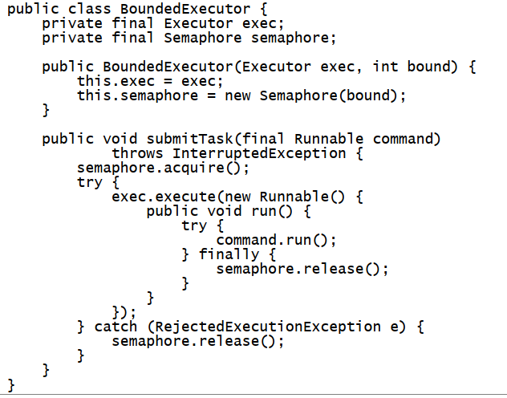
Using Semaphore to throttle Task Submission

Slide 19
Extending Thread Factory
Thread Pools creates Thread using a Thread Factory
In such cases we can make use of Custom Thread Factory to give a meaningful name, set an UncaughtExceptionHandler for pool threads.

Slide 20
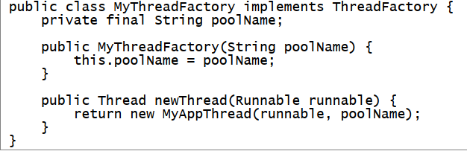
Extending Thread Factory

Slide 21
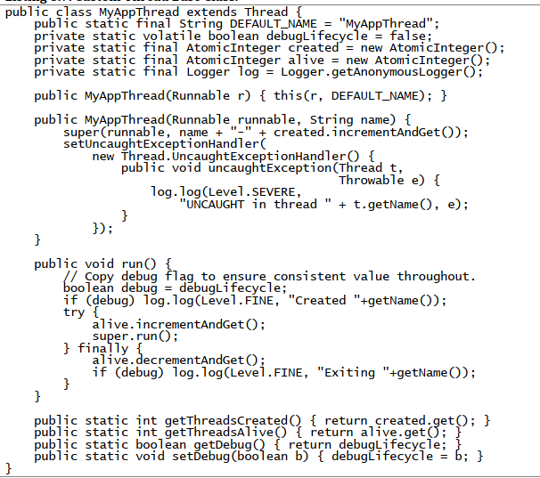
Extending Thread Factory

Slide 22
Extending Thread Pool Executors
Java Thread Pool Executor can be extended to provide some very important statistics.
After extension we can override beforeExecute, afterExecute and terminate methods.
Above all are hook methods.
beforeExecute and afterExecute is called in Threads executing the tasks.
beforeExecute is called before task execution by a Thread.
afterExecute is called after tasks returns normally or when an Exception is thrown.
afterExecute will not be called when Error is thrown from task execution
If beforeExecute throws a RuntimeException then, task is not executed and afterExecute is not called
The terminated hook is called when thread pool is shutdown and all tasks are processed and worker threads have shutdown.

Slide 23
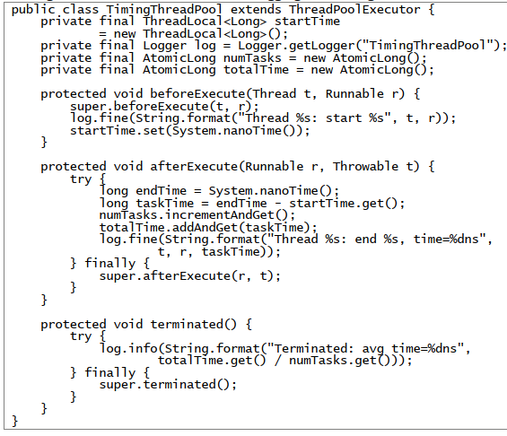
Extending Thread Pool Executors

Slide 24

Thread Contention and Context Switch
How much serialization is too much serialization?
Amaldahl’s Law: , if there is too much synchronization (serialization) in code then increasing the number of Threads or Processors will have no effect on performance. If there is equal to more than 50% of serialization, then you cannot increase performance more than twice even with infinite no of processors

Slide 25
Thread Contention and Context Switch
Threads creation, tear down always have a cost associated with. When a Thread is blocked for operation then context switch happens. Context Switch can happen because of given below reasons:
If No of Threads > No of CPU
If Threads are locked due to synchronization
I/O Blocking
Context Switch has given below effects:
Manipulation of Thread’s data structure in JVM
Putting new Thread into service
The new Thread may not see latest values of shared variables, hence all states are copied to local cache
The new Thread may process slowly due to this (slower than when it was first launched)
This context switch operation kills up CPU time, it means your program will get leas CPU time, thus overall application’s performance will degrade

Slide 26
Thread Contention and Context Switch
A program with more synchronization and I/O blocking context switches more than CPU-bound tasks

Slide 27
Cost of Synchronization
Synchronization makes use of special mechanism called “Memory Barriers” to make code Thread safe
Memory Barriers also inhibit certain optimization operation done by compiler. For example, in a non-synchronized code, compiler may re-order statements for optimization, this re-ordering however will be inhibited in a synchronized region
Modern JVMs can reduce the cost of synchronization by automatically removing undesirable synchronizations. For example:
Escape Analysis: JVM checks if a reference is never published to heap then it removes the synchronization
Lock Elision: See code snippet below:
Private void m1(){
List list = new Vector
List.add
List.add
List.add
}
Here at run time JVM will see that list is local variable hence it will eliminate the lock associated with the Vector. This is available only in IBM Hot Spot JVM
Lock Coarsing: JVM can also combine same type of lock acquisition (just in above example) into a single one

Slide 28
Cost of Synchronization
You can also avoid cost associated with synchronization:
Use Lock Splitting: Guard different variables with different locks
Use Lock Stripping just like Concurrent Hash Map where not complete map is locked for map operations
Use concurrent collections.
Use Immutable classes
Use Local variables instead of instance variables

Slide 29
Generic Principles/Pitfalls
Use Immutable Classes
Use local variables
One can avoid deadlocks using Locks and Reentrant, but BEWARE using this high-level APIs:
Releasing Locks
Thread Dump Analysis (No Precise information)
Use private lock instead of intrinsic locks:
For example:
public class SomeObject {
// Locks on the object's monitor
public synchronized void changeValue() {
// ...
}
public static SomeObject lookup(String name) {
// ...
}
}

Slide 30
Generic Principles/ Pitfalls
Unsafe Publication:
Class Foo{
Private Helper helper
Public Helper getHelper(){return helper;}
Public void initialize(){helper = new Helper(42);}
}
Class Helper{
Private int n;
Public Helper(int n){ n = n;}
}

Slide 31
Generic Principles/Pitfalls
If Thread 1 access helper before initialize is called then Thread 1 will see helper reference as null. Now let’s say Thread 2 calls initialize method and Thread 3 calls getHelper method. Now given below things can be observed by Thread 3
➢ Thread 3 observes helper reference as null.
➢ Thread 3 observes fully constructed Helper object with value of n as 42
➢ Thread 3 observes partially constructed Helper object with default value of n as 0
This is because Java Memory Model (JMM) permits compiler to allocate memory to the new Helper object and assign a reference to it and then initialize instance fields of helper instance. In other words, compiler reorders the write to the helper instance field (allocating memory to Helper object) and then write to instance field of helper Object n. Thus, a Thread can see a partially constructed object.

Slide 32
Generic Principles/ Pitfalls
Compiler Re-ordering for optimization:
Without synchronization some Java compiler and run time environment can also do some weird re-ordering of statements for performance. See example below:
Shared variable done
Shared variable int i
Thread 1 :
while(!done){
i= 1;
//do something
}
SYSO(i)
Thread 2:
i= 3;
done = true
Thread 1 will exit loop and may also print 1, because of re-ordering of statements by Java compiler
VERY WEIRD AND SCARY INDEED
Above problem is known as STALENESS.
Synchronization ensures that variable’s latest value is read by Threads.

Slide 33
References and further study
Java Concurrency In Practice By Joshua Bloch
Akka Framework: Open-source library to develop concurrent and distributed applications in Java or Scala by leveraging the Actor Model

